Slide 1

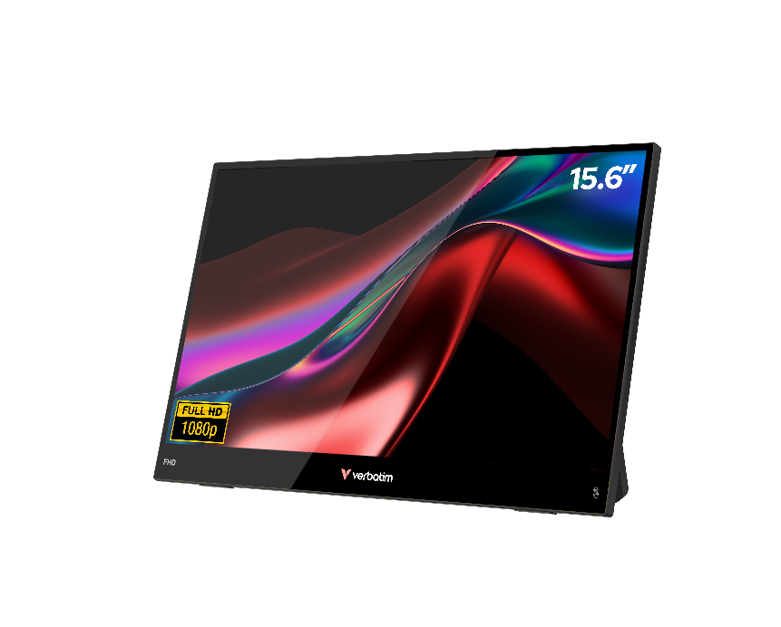
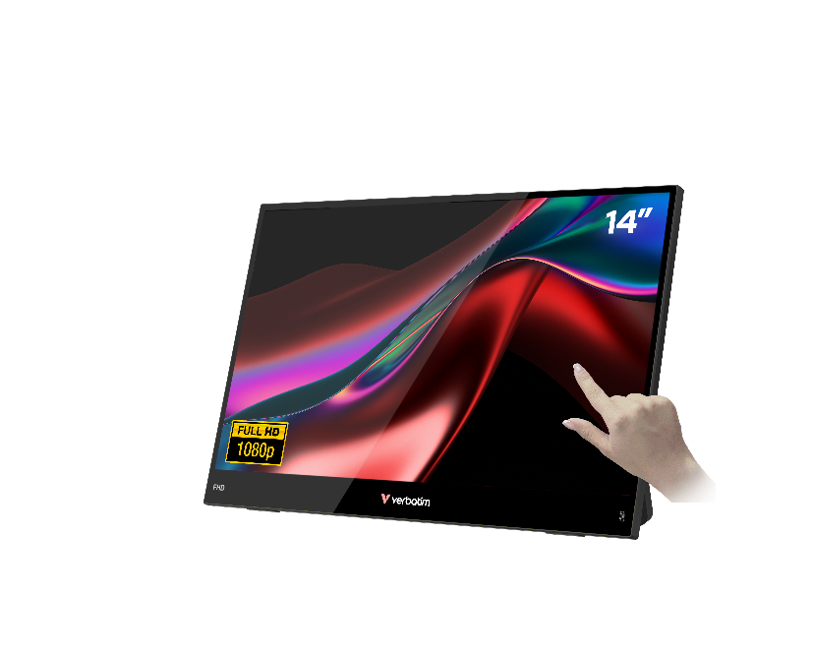
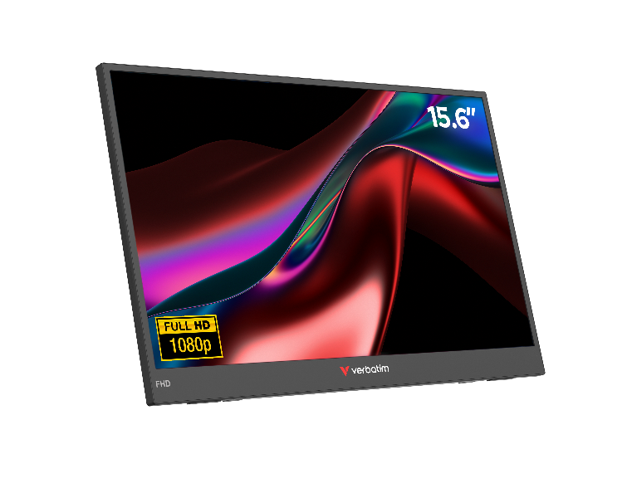



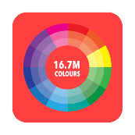



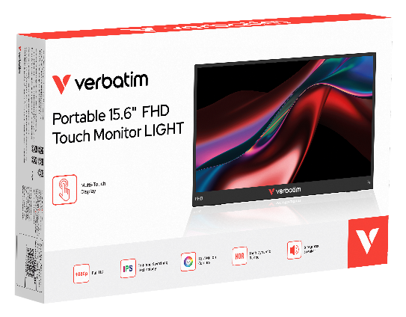
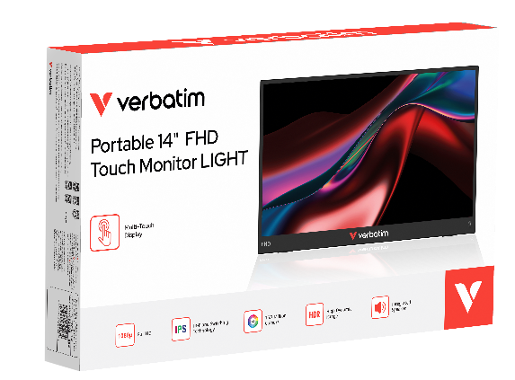
Portable Monitor LIGHT
FHD 1080p Touch & Non-Touch
PN: 32400, 32401, 32402
Description
Verbatim’s Portable Monitors LIGHT series is designed for users who require high-quality, compact displays for productivity and entertainment on the go.
The family comprises three models: a 14″ touchscreen, a 15.6″ touchscreen, and a 15.6″ non-touch. Each model features a Full HD (1920 × 1080) resolution with an IPS panel, delivering sharp images and consistent colour reproduction across a 178° wide viewing angle.
With an ultra-slim and lightweight design, integrated speakers, and an audio jack, these monitors offer versatile functionality.
All units include a protective neoprene sleeve for secure and convenient portability.
Full HD Resolution (1920×1080) with 16:9 Aspect Ratio & 16.7 million colours
Touchscreen version uses 10-Point Capacitive Multi-Touch for fast and precise touch control thanks to the Glass+Glass Touch Panel.
Easy USB-C Connection – plug & play, one cable for video, power, and touch (where available)
IPS Panel with 178° Viewing Angle – clear images from any direction
HDR Technology – enhanced picture quality and vibrant colours
Wide Device Compatibility – works with PC, Mac, tablets, smartphones, and consoles via USB-C or HDMI
Ultra-Slim & Lightweight Design – perfect for travel and mobile work
Built-In Speakers & Audio Jack – no extra sound system needed
Multi-lingual On Screen Display
* Only for Windows

Slide 2
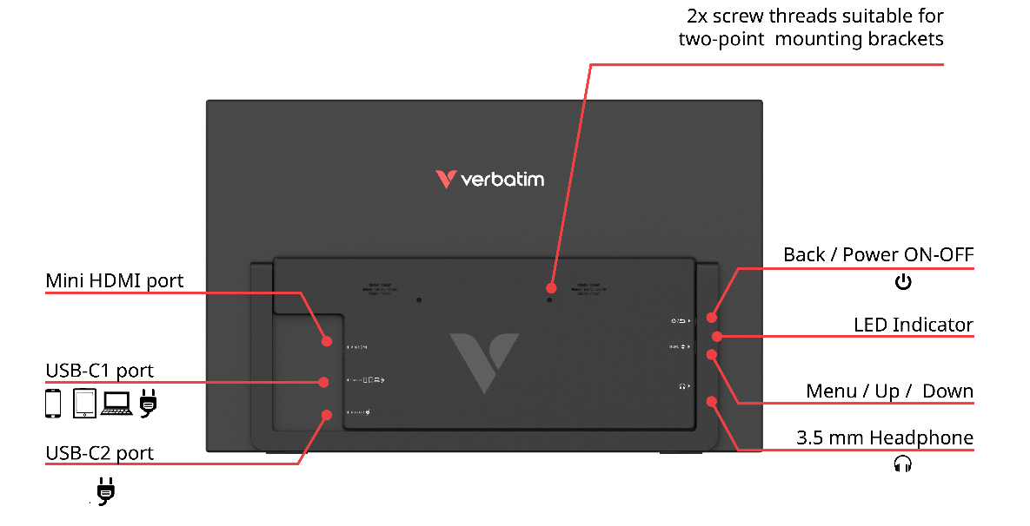
Portable Monitor LIGHT
FHD 1080p Touch & Non-Touch
PN: 32400, 32401, 32402
PN | Panel | Size | Resolution (H x V) | Touch | Wall Mounting | Power | Video | Case | Weight
32400 | IPS | 14" | FHD 1920x1080 | Capacitive G+G, Multi-Touch | 2 screw threads, 75mm apart | USB-C | USB-C / Mini HDMI | Plastic | 778.2 g
32401 |  | 15.6 |  | No |  |  |  |  | 682.0 g
32402 |  | 15.6 |  | Capacitive G+G, Multi-Touch |  |  |  |  | 973.2 g
Features
Brightness (typical): 220-250cd/m² (Typ.)
NTSC: 45%
Contrast (typical): 1000:1 (Typ.)
Refresh rate: 60 Hz
Active area (mm): 14” 309.31×173.99, 15.6” 344.16×193.59 mm (H×V)
Pixel pitch (mm): 14” 161.1×161.1, 15.6”: 179.25×179.25 um (H×V)
Resolution (H x V): 1920*1080
Aspect ratio: 16:9
Response Time:
  Typical GTG:10ms, Typical Tr+Tf: 20ms, Btw: 20ms
View angles LR,DU (CR>10): 89/89/89/89 (Typ.)(CR>10)
Languages
Front of pack: English
Back and Side of Pack: Product info in English, French, Spanish
Back of Pack: English, French, German, Dutch, Italian, Spanish, Portuguese, Polish, Russian, Czech, Hungarian, Slovakian, Croatian, Serbian, Romanian, Turkish, Traditional Chinese, Simplified Chinese, Korean, Japanese
Quick Installation Languages:
English, French, German, Traditional Chinese + Technical Support text in English, French, German, Dutch, Italian, Spanish, Portuguese, Polish, Russian, Czech, Hungarian, Croatian, Serbian, Slovakian, Romanian, Turkish, Traditional Chinese, Simplified Chinese, Korean, Japanese

Slide 3
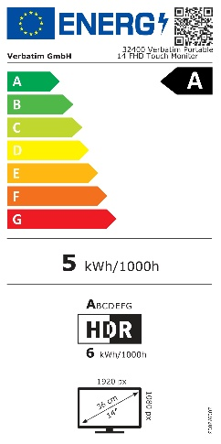
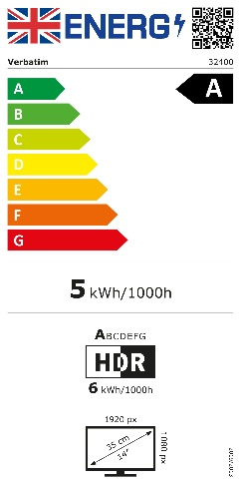
Portable Monitor LIGHT
FHD 1080p Touch & Non-Touch
Reorder No. | Description | Tariff Code | Barcode | EAN-128 | EAN-14
32400 | Verbatim Portable 14" FHD Touch Monitor LIGHT | 8528521210 | 023942324003 | (02)00023942324003(37)02(91)863 (02)00023942324003(37)06(91)863 | 20023942324007 50023942324008
32401 | Verbatim Portable 15.6" FHD Monitor LIGHT | 8528521210 | 023942324010 | (02)00023942324010(37)02(91)863 (02)00023942324010(37)06(91)863 | 20023942324014 50023942324015
32402 | Verbatim Portable 15.6" FHD Touch Monitor LIGHT | 8528521210 | 023942324027 | (02)00023942324027(37)02(91)863 (02)00023942324027(37)06(91)863 | 20023942324021 50023942324022
Reorder No. | 32400 | 32401 | 32402
Product Dimensions L x W x H | 320.8 x 203.9 x 17.34 mm | 355.5 x 221.5 x 17.25 mm | 355.8 x 222.3 x 17.68 mm
Product Weight | 778.2 g | 682 g | 973.2 g
Units per Pack | 1
Pack Dimensions L x W x H | 462.6 x 280 x 57.5 mm
Pack Weight | 1830 g | 1736 g | 2028 g
Units per Inner Carton | 2
Inner Carton Dimensions L x W x H | 490 x 300 x 130 mm
Inner Carton Weight | 3760 g | 4054 g | 4070 g
Units per Outer Carton | 6
Outer Carton Dimensions L x W x H | 520 x 440 x 330 mm | 510 x 460 x 325 mm | 520 x 440 x 330 mm
Outer Cartons Weight | 13138 g | 13246 g | 14314 g
Outer Cartons per Layer | 4
Layers per Pallet | 3
Units per Pallet | 72
Pack Content :
• Verbatim Portable Monitor
• USB-C to USB-C cable (1.0m)
• USB-A to USB-C cable (1.0m)
• Mini HDMI-HDMI cable (1.0m)
• EU power supply with UK adapter (5V, 2A)
• Neoprene protection sleeve
• Quick Installation Guide

