Slide 1
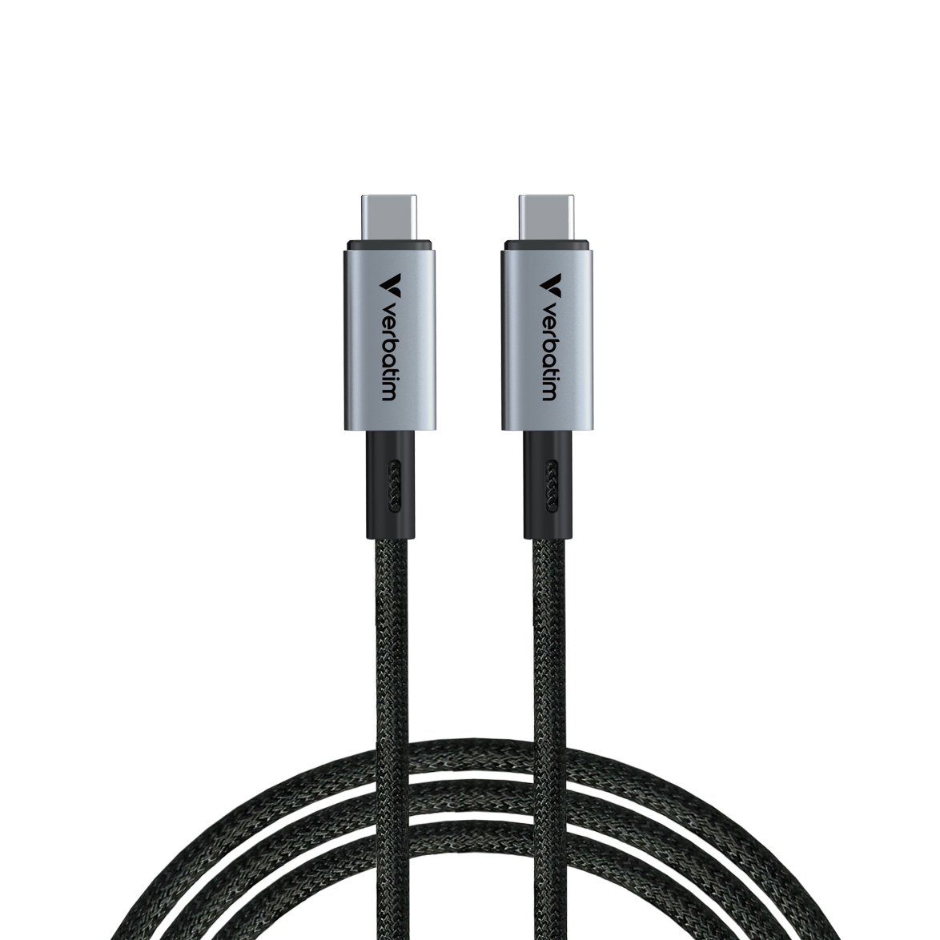
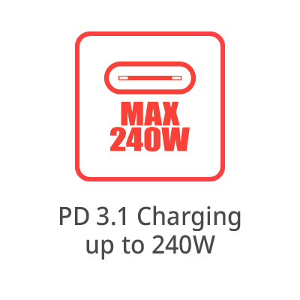
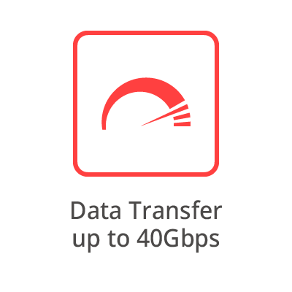
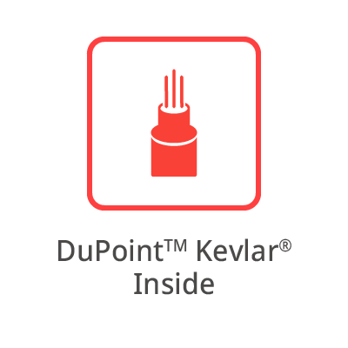
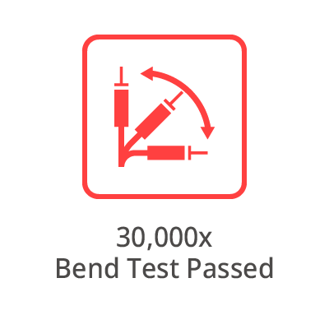
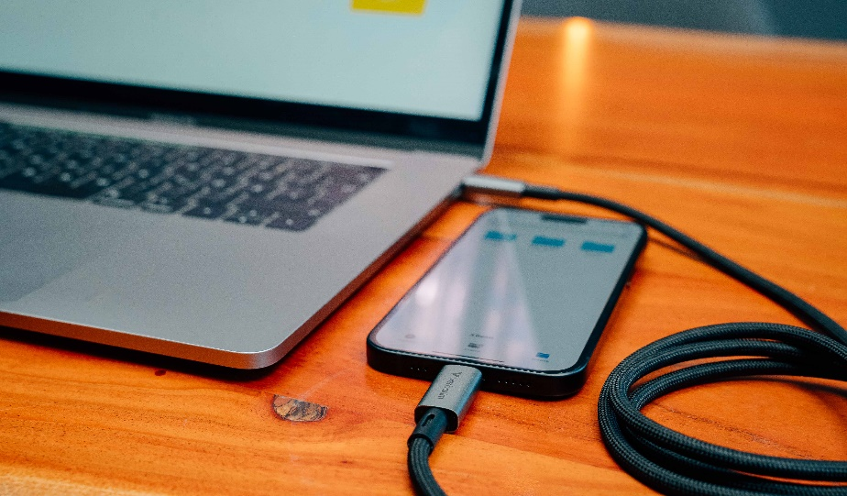
Sync & Charge
USB-C to USB-C Cable
PN: 31847
Description
Power up your devices and productivity with Verbatim’s Sync & Charge 240W USB-C to USB-C USB4 Cable. Designed to meet the demands of high-performance devices, this cable combines industry-leading charging power, lightning-fast data transfer, and superior durability.
Key Features:
240W Power Delivery (PD 3.1): Charge laptops, gaming systems, and power-hungry devices faster than ever, ensuring maximum efficiency.
40Gbps Data Transfer: Transfer large files, 4K/8K videos, and more in seconds with cutting-edge USB4 technology.
Aramid Fiber Construction: Reinforced for exceptional strength and longevity, standing up to everyday wear and tear.
Universal Compatibility: Perfect for the latest USB-C devices, including laptops, smartphones, external drives, and high-resolution monitors.
Passed 30,000 Bend Test: Built to withstand rigorous daily use while maintaining peak performance.
Future-Ready Performance: USB4 ensures you’re equipped for the next generation of connectivity, supporting Thunderbolt 3/4 devices.
Elevate your connectivity game with Verbatim’s Sync & Charge 240W USB-C to USB-C USB4 Cable – the perfect blend of power, speed, and reliability. Whether charging, transferring, or streaming, this cable delivers top-tier performance to keep you ahead of the curve.

Slide 2
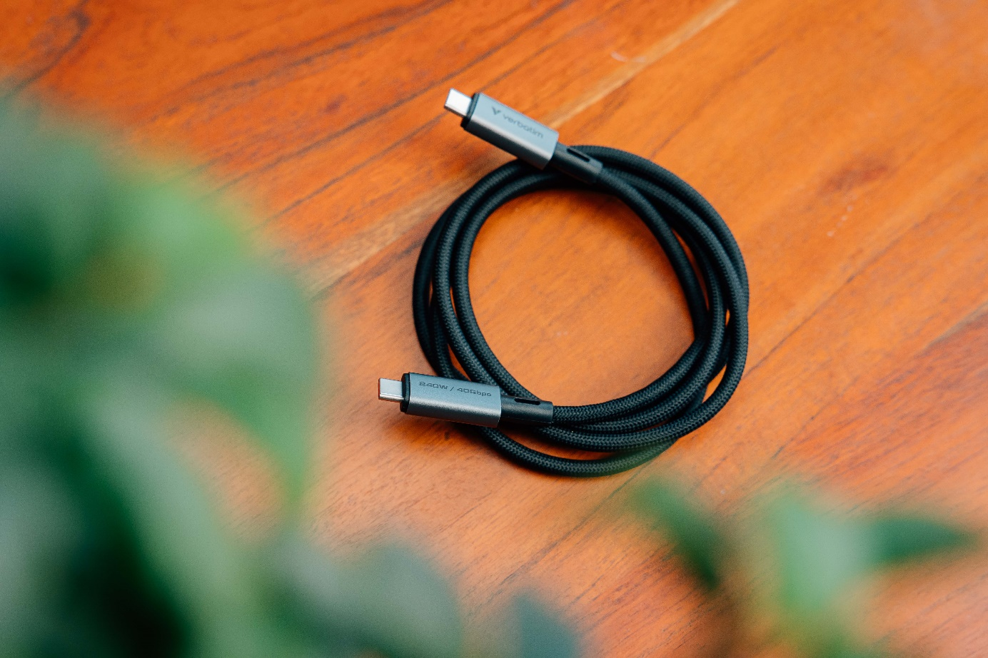
Sync & Charge USB-C to USB-C Cable
PN: 31847
Specifications
Connectors: USB-C® to USB-C®
Length: 120cm
Diameter: 5.1mm
Materials: Aluminium, nylon, TPE, *DuPontTM Kevlar® inner fibres
Data Transfer Speed: Up to 40Gbps
Max Power Output: 240W
Charging Standards: PD 3.1
* DuPontTM and Kevlar® are trademarks or registered trademarks of affiliates of DuPont de Nemours, Inc.
Pack Contents
Verbatim USB-C to USB-C USB4 cable 120cm
Quick Start Guide
Languages
Front of pack: English
Back of pack: English, French, German, Dutch, Italian, Spanish, Portuguese, Polish, Russian, Czech, Hungarian, Serbian, Croatian, Traditional Chinese, Simplified Chinese, Korean, Japanese
Quick Installation Languages
English, German, French, Traditional Chinese + Technical support text in English, French, German , Dutch, Italian, Spanish, Portuguese, Polish, Russian, Czech, Hungarian, Serbian, Croatian, Traditional Chinese, Simplified Chinese, Korean, Japanese
PN | Charging Power | Data Transfer
31847 | Up to 240W PD 3.1 | 40Gbps

Slide 3
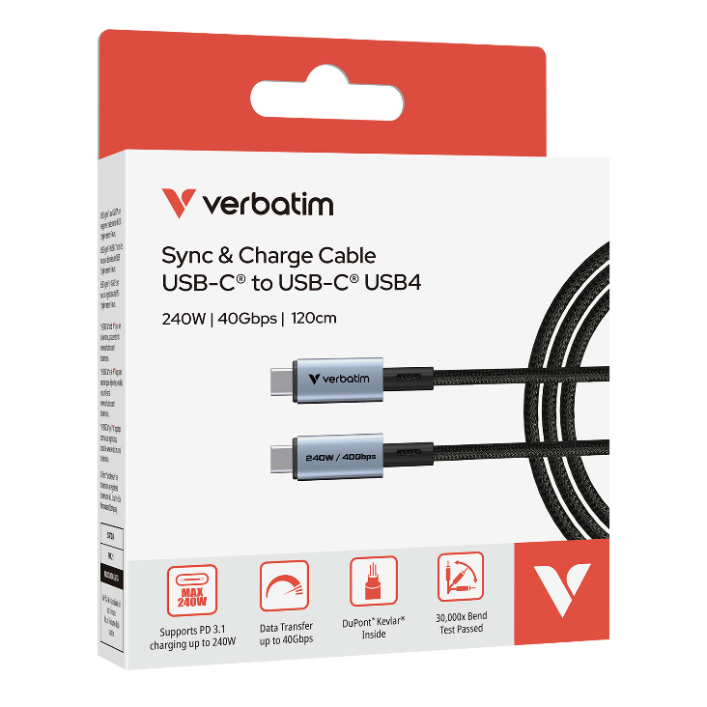
Sync & Charge USB-C to USB-C Cable
Reorder No. | Description | Tariff Code | Barcode | EAN-128 | EAN-14
31847 | Verbatim Sync & Charge Cable USB-C to USB-C 240W 40 Gbps120 cm | 85444290 | 023942318477 | (02)00023942318477(37)10(91)847 (02)00023942318477(37)40(91)847 | 20023942318471 50023942318472
Reorder No. | 31847
Product Length | 1200 mm
Product Weight | 47.1 g
Units per Pack | 1
Pack Dimensions L x W x H | 141 x 85.5 x 21.6 mm
Pack Weight | 73.9 g
Units per Inner Carton (MOQ) | 10
Inner Carton Dimensions L x W x H | 223 x 180 x 114 mm
Inner Carton Weight | 759 g
Units per Outer Carton | 40
Outer Carton Dimensions L x W x H | 385 x 243 x 258 mm
Outer Cartons Weight | 3396 g
Outer Cartons per Layer | 9
Layers per Pallet | 4
Units per Pallet | 1440

