Slide 1
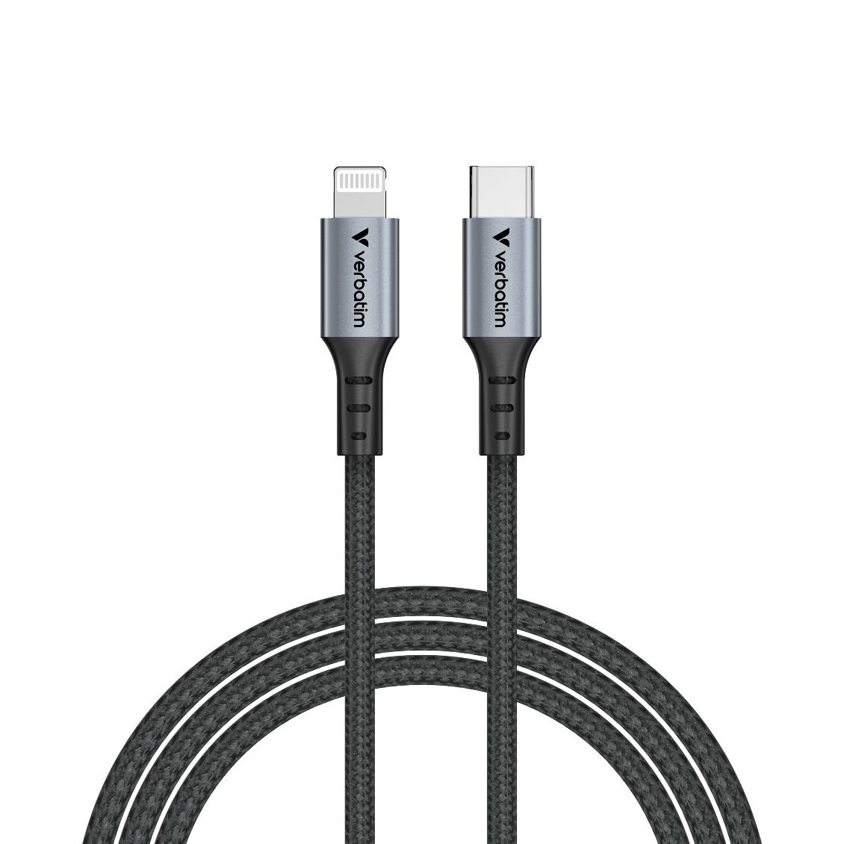

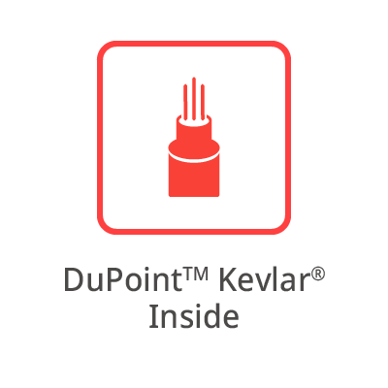
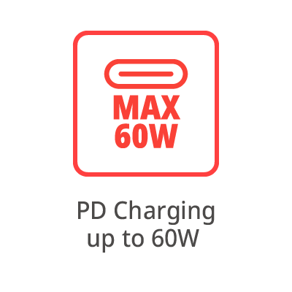
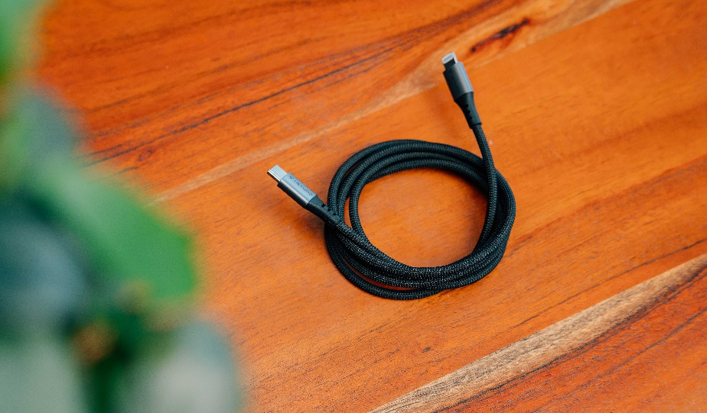
Sync & Charge USB-C to Lightning Cable
PN: 31844
Description
Performance meets durability with Verbatim’s USB-C to Lightning Sync & Charge Cable. Designed for modern devices and demanding users, this premium cable combines cutting-edge technology with robust construction for fast, reliable charging and data transfer.
Key Features:
Apple’s MFi-certified ensures compatibility to Apple devices
60W PD Fast Charging: Charge iPad, and iPhone at quick charging speeds, saving time and maximizing productivity.
Aramid Fiber construction: Reinforced for exceptional strength, making it resistant to wear and tear.
Passed 50,000 Bend Test: Built to withstand rigorous daily use while maintaining peak performance.
High-Speed Data Transfer (480Mbps): Transfer files, videos, and photos in seconds.
120cm Length: Perfect for use at home, in the office, or on the go.
Engineered for those who demand the best, Verbatim’s 60W USB-C to Lightning Sync & Charge Cable delivers powerful charging, seamless data transfer, and unparalleled durability. Upgrade your tech essentials today and stay connected anywhere, everyday with Verbatim.

Slide 2
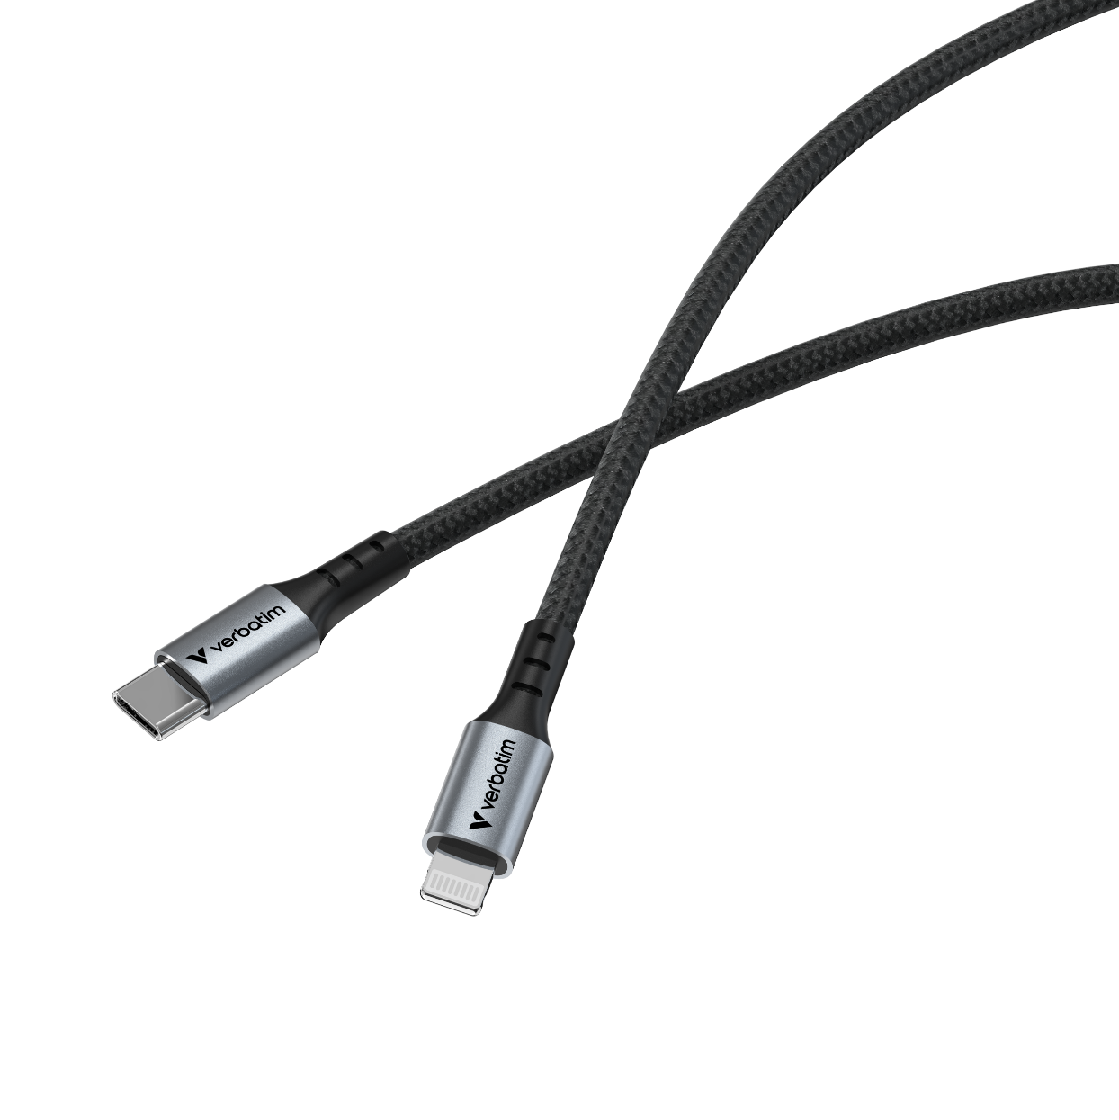
Sync & Charge Cable USB-C to Lightning
PN: 31844
Specifications
Connectors: USB-C® to Lightning
Length: 120cm
Diameter: 3.8mm
Materials: Aluminium, nylon, TPE, *DuPontTM Kevlar® inner fibres
Data Transfer Speed: Up to 480Mbps
Max Power Output: 60W
Charging Standards: PD 3.0
* DuPontTM and Kevlar® are trademarks or registered trademarks of affiliates of DuPont de Nemours, Inc.
Pack Contents
Verbatim USB-C to to Lightning cable 120cm
Quick Start Guide
Languages
Front of pack: English
Back of pack: English, French, German, Dutch, Italian, Spanish, Portuguese, Polish, Russian, Czech, Hungarian, Serbian, Croatian, Traditional Chinese, Simplified Chinese, Korean, Japanese
Quick Installation Languages
English, German, French, Traditional Chinese + Technical support text in English, French, German , Dutch, Italian, Spanish, Portuguese, Polish, Russian, Czech, Hungarian, Serbian, Croatian, Traditional Chinese, Simplified Chinese, Korean, Japanese
PN | Charging Power | Data Transfer
31844 | Up to 60W | 480 Mbps

Slide 3
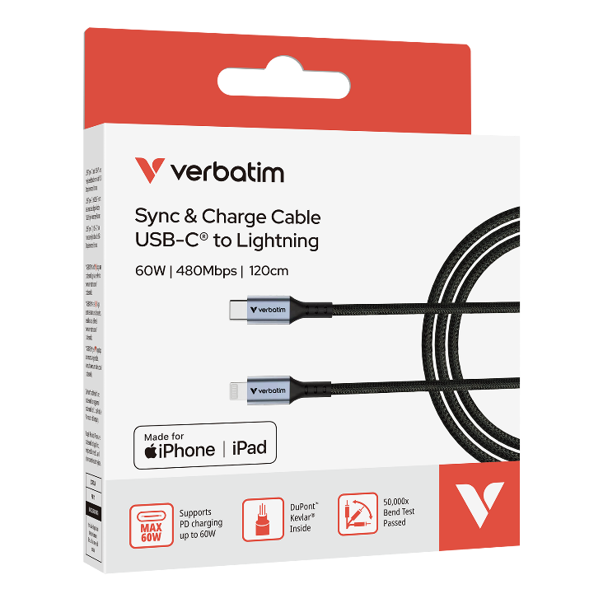
Sync & Charge Cable USB-C to Lightning
Reorder No. | Description | Tariff Code | Barcode | EAN-128 | EAN-14
31844 | Verbatim Sync & Charge Cable USB-C to Lightning 120 cm | 85444290 | 023942318446 | (02)00023942318446(37)10(91)847 (02)00023942318446(37)40(91)847 | 20023942318440 50023942318441
Reorder No. | 31844
Product Length | 1200 mm
Product Weight | 28 g
Units per Pack | 1
Pack Dimensions L x W x H | 141 x 85.5 x 21.6 mm
Pack Weight | 54.8 g
Units per Inner Carton (MOQ) | 10
Inner Carton Dimensions L x W x H | 223 x 165 x 114 mm
Inner Carton Weight | 568 g
Units per Outer Carton | 40
Outer Carton Dimensions L x W x H | 355 x 243 x 258 mm
Outer Cartons Weight | 2632 g
Outer Cartons per Layer | 9
Layers per Pallet | 4
Units per Pallet | 1440

