Slide 1
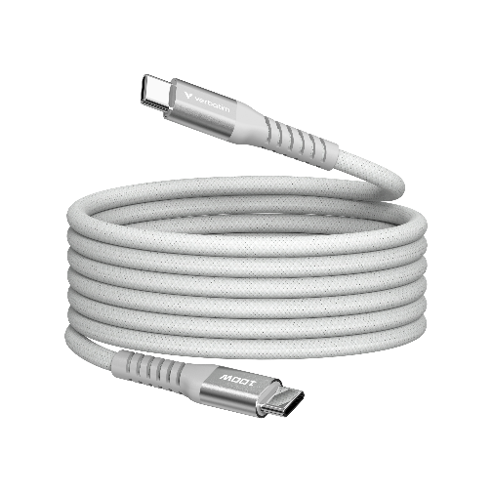


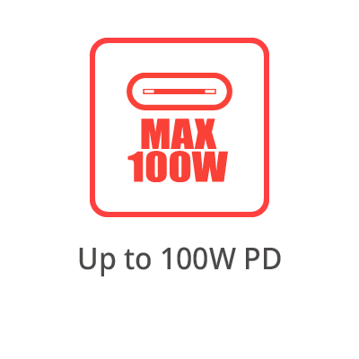
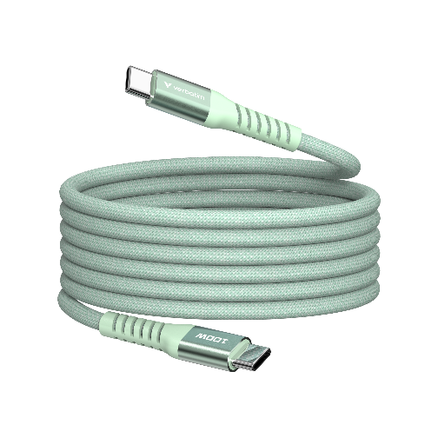
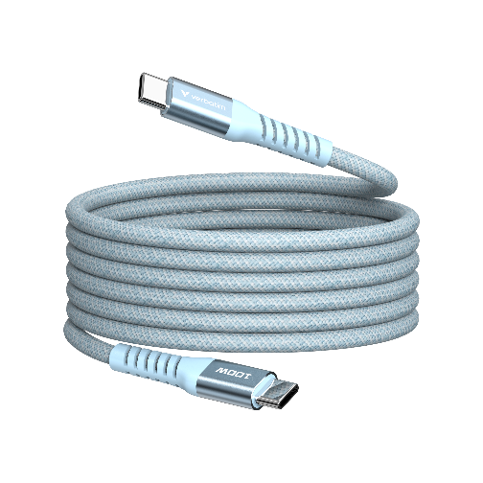
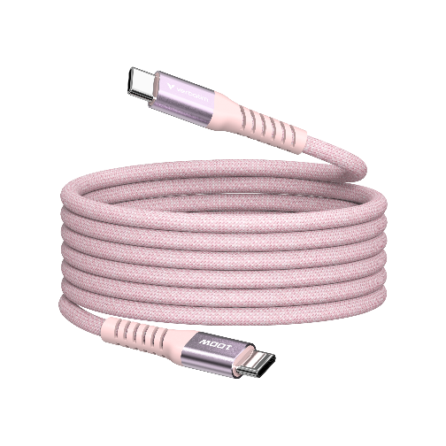
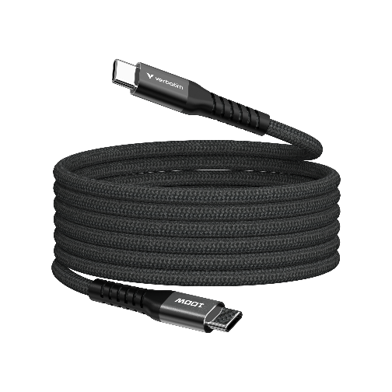
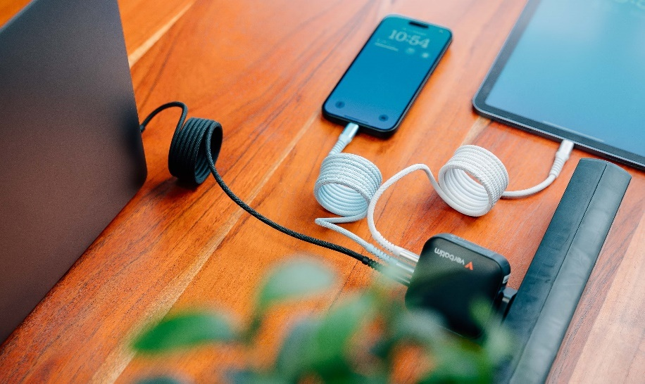
Sync & Charge
USB-C to USB-C Magnetic Cable
PN: 31854, 31855, 31856, 31857, 31863
Description
Upgrade your charging and data transfer experience with Verbatim’s 100W USB-C to USB-C Sync & Charge Magnetic Cable. Engineered for maximum efficiency, this high-speed cable supports 100W Power Delivery (PD), making it perfect for charging laptops, tablets, and smartphones at lightning-fast speeds.
Key Features:
100W PD Fast Charging: Power your devices with unmatched efficiency, reducing downtime.
Tangle-Free Magnetic Design: Coils neatly away for easy storage.
High-Speed Data Transfer: Transfer files, photos, and videos in seconds with up to 480Mbps speed.
120cm Length: Long enough for convenience, compact enough for portability.
Passed 30,000 Bend Test: Built to withstand rigorous daily use while maintaining peak performance.
Universal Compatibility: Works with USB-C enabled devices, including MacBooks, smartphones, and tablets.
Built for convenience, durability, and power, Verbatim’s 100W USB-C to USB-C Sync & Charge Magnetic Cable is your go-to solution for all your charging and connectivity needs. Fast, reliable, and tangle-free – redefine the way you sync and charge!

Slide 2
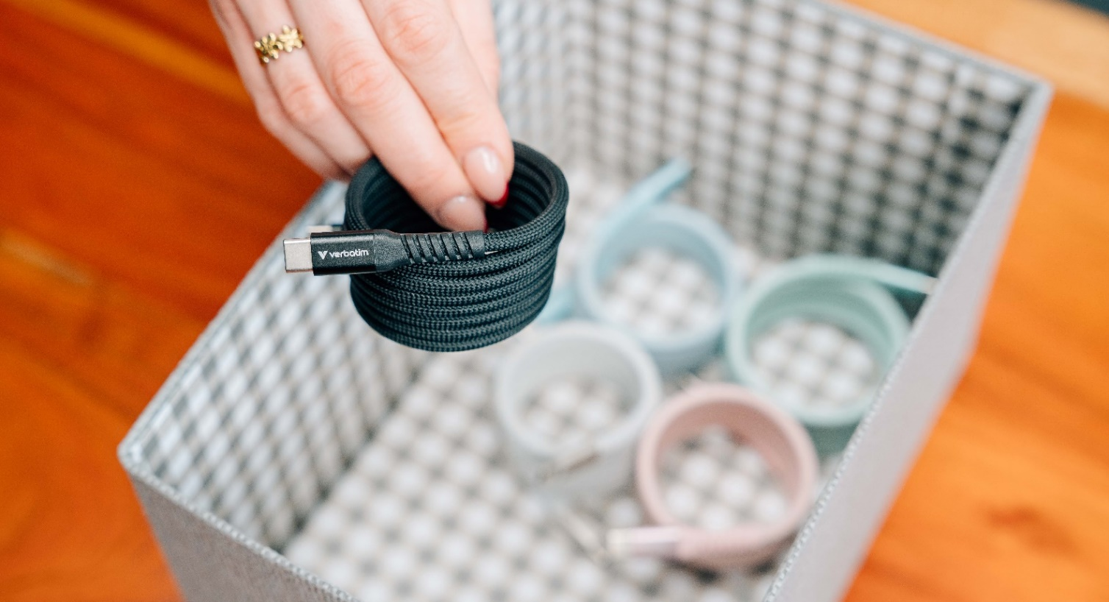
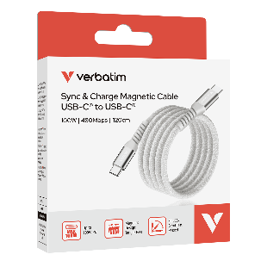
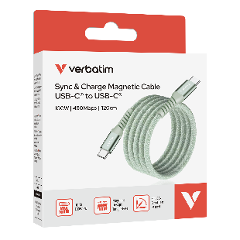
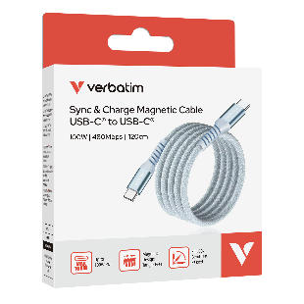
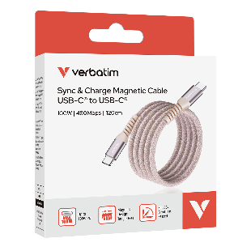
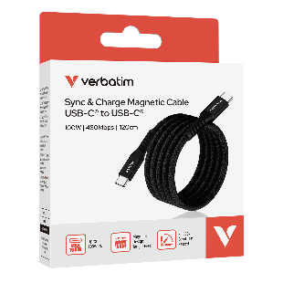
Sync & Charge
USB-C to USB-C Magnetic Cable
PN: 31854, 31855, 31856, 31857, 31863
Specifications
Interfaces: USB-C ® to USB-C ®
Cable length: 120cm
Cable diameter: 4.6mm
Material: Aluminium, nylon, TPE,
Data transfer rate: Up to 480 Mbps
Output power: Max 100W
Supports: PD 3.0, QC 3.0
Pack Contents
Verbatim USB-C to USB-C cable 120cm
Quick Start Guide
Languages
Front of pack: English
Back of pack: English, French, German, Dutch, Italian, Spanish, Portuguese, Polish, Russian, Czech, Hungarian, Serbian, Croatian, Traditional Chinese, Simplified Chinese, Korean, Japanese
Quick Installation Languages
English, German, French, Traditional Chinese + Technical support text in English, French, German , Dutch, Italian, Spanish, Portuguese, Polish, Russian, Czech, Hungarian, Serbian, Croatian, Traditional Chinese, Simplified Chinese, Korean, Japanese
PN | Charging Power | Data Transfer
31854, 31855, 31856, 31857, 31863 | Up to 100W | 480 Mbps

Slide 3
Sync & Charge
USB-C to USB-C Magnetic Cable
Reorder No. | Description | Tariff Code | Barcode | EAN-128 | EAN-14
31854 | Verbatim Sync & Charge Cable USB-C to USB-C 100W Magnetic 120 cm - Grey | 85444290 | 023942318545 | (02)00023942318545(37)10(91)893 (02)00023942318545(37)40(91)893 | 20023942318549 50023942318540
31855 | Verbatim Sync & Charge Cable USB-C to USB-C 100W Magnetic 120 cm - Green |  | 023942318552 | (02)00023942318552(37)10(91)893 (02)00023942318552(37)40(91)893 | 20023942318556 50023942318557
31856 | Verbatim Sync & Charge Cable USB-C to USB-C 100W Magnetic 120 cm - Blue |  | 023942318569 | (02)00023942318569(37)10(91)893 (02)00023942318569(37)40(91)893 | 20023942318563 50023942318564
31857 | Verbatim Sync & Charge Cable USB-C to USB-C 100W Magnetic 120 cm - Pink |  | 023942318576 | (02)00023942318576(37)10(91)893 (02)00023942318576(37)40(91)893 | 20023942318570 50023942318571
31863 | Verbatim Sync & Charge Cable USB-C to USB-C 100W Magnetic 120 cm - Black |  | 023942318637 | (02)00023942318637(37)10(91)847 (02)00023942318637(37)40(91)847 | 20023942318631 50023942318632
Reorder No. | 31854 | 31855 | 31856 | 31857 | 31863
Product Length | 1200 mm
Product Weight | 54 g
Units per Pack | 1
Pack Dimensions L x W x H | 141 x 101.5 x 28 mm
Pack Weight | 85.8 g
Units per Inner Carton (MOQ) | 10
Inner Carton Dimensions L x W x H | 223 x 180 x 114 mm
Inner Carton Weight | 878 g
Units per Outer Carton | 40
Outer Carton Dimensions L x W x H | 385 x 243 x 258 mm
Outer Cartons Weight | 3872 g
Outer Cartons per Layer | 9
Layers per Pallet | 4
Units per Pallet | 1440

